Slide 1


Slide 2

Group-20
Auroasish Palatsingh-2201020365
Soumyaranjan Sahoo- 2201020420
Sparsh Athghara- 2201020421

Slide 3
Content
Introduction
Proposed Solution
Algorithm
Conclusion
Flow Chart
Problem We Face
Advantages

Slide 4
Introduction
In today's educational landscape, the management of student information stands as a critical cornerstone for efficient administrative operations and academic excellence. Educational institutions encounter a myriad of challenges in handling extensive volumes of student data, requiring a robust system for effective management.

Slide 5
Problem We Face
Data Security and Privacy Concerns
System Integration and Compatibility
Data Analysis and Reporting

Slide 6





Proposed Solution
Overview
The proposed solution is a robust and integrated system designed specifically for managing student data efficiently within educational institutions.
Key Components:
Key Functionalities:
Centralized Database
User-Friendly Interface
Data Security Measures
Data Validation and Accuracy Checks
Scalability and Performance Optimization

Slide 7
Description
Key Components
Centralized Database:
A centralized repository to store and manage student information securely.
User-Friendly Interface:
Intuitive interface facilitating easy access and management of data for administrators, teachers, and staff.
Key Features
Data Security Measures:
Implementing encryption protocols and access controls to ensure data security and prevent unauthorized access.
Data Validation and Accuracy Checks:
Automated validation processes to maintain data accuracy, flagging inconsistencies or errors for prompt correction.
Scalability and Performance Optimization:
Scalable architecture capable of handling large volumes of data efficiently without compromising system performance.

Slide 8
Algorithm
1. Initialize the MySQL connection admin with the provided credentials.
2. Implement a menu-driven interface that allows the user to choose from the following options:
a. Add a new student:
b. Edit student information:
c. Delete a student:
d. Show student data:
e. Export student data to CSV:
f. Search Students:
g. Import data from CSV to MySQL:
h. Exit: Terminate the program.

Slide 9
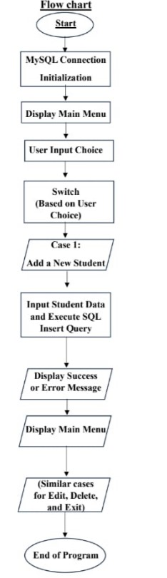
Flow Chart

Slide 10
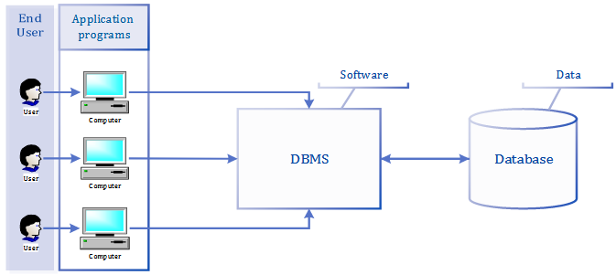

Slide 11
Advantages
1
2
Efficient Data Retrieval and Reporting
3
Enhanced Accessibility and Availability
Centralized Data Management

Slide 12
Conclusion
In conclusion, the existing Student Database Management System (SDMS) code provides a foundational structure for student data management. Although it meets fundamental requirements, imperative advancements are needed to rectify security vulnerabilities, refine the database design, and introduce advanced functionalities. By adopting recommended enhancements, the SDMS can undergo substantial evolution, becoming a resilient, secure, and feature-rich solution. This transformation is crucial to meet the dynamic demands of educational institutions, offering an encompassing platform for streamlined and efficient student information management.

Slide 13
Thank You!!

